Slide 1


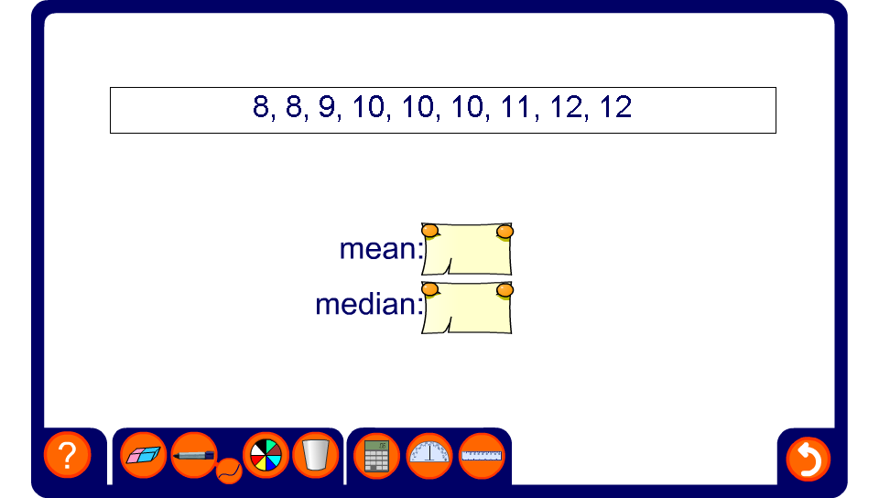


Outliers and the median and mean
Notes:
This activity illustrates the way that outliers affect the mean but do not affect the median. For each set of data, say which would be the most appropriate average and why.

